Slide 1

Fake news detection using machine learning
Ronish shrestha Kce075bct032
Roshan shrestha Kce075bct033
Rubin baidhya Kce075bct034
Sairush tamang kce075bct036

Slide 2
Fake news
Title and content being different.
Released source is not credible.
Author is not mentioned.
Misleading headlines and satire or parody content

Slide 3
Problem
Mislead the readers and create a devastating impact on people's mindset.
Encroach human right and public safety.
Not enough Nepali dataset.

Slide 4
objectives
To reduce the effort and time to detect fake news.
To classify news as fake or real as it is a major problem.

Slide 5
scope
Help in minimizing spread of disinformation
1
Protect people's right to true information
2
Identify real news from fake news
3

Slide 6
Requirements analysis
Software Requirements
Functional Requirements
Non-Functional Requirements
System Requirements

Slide 7
Software Requirement
Python
Keras
TensorFlow
Beautiful Soup

Slide 8
Functional Requirements
Adaptable and elaborated from the point of view of the users.
01
Should figure out the news that are completely fake or not genuine
02
Should extract the news article from online news portal
03

Slide 9
Non-Functional requirements
Reliability
Maintainability
Performance
Accuracy

Slide 10

Feasibility analysis
Time Feasibility
Size Feasibility
Technical Feasibility
Economic Feasibility
Operational Feasibility

Slide 11
Why lstm??
Well suited for classification and predictions
Understand context along with recent dependencies
Can deal with vanishing gradient problem seen in RNN

Slide 12
Why svm??
Best for Text Classification
Uses Kernel function
Can be used for Linear and Non-linear data.

Slide 13
methodology

Slide 14

Software development approach
Planning
Development
Testing
Evaluation

Slide 15
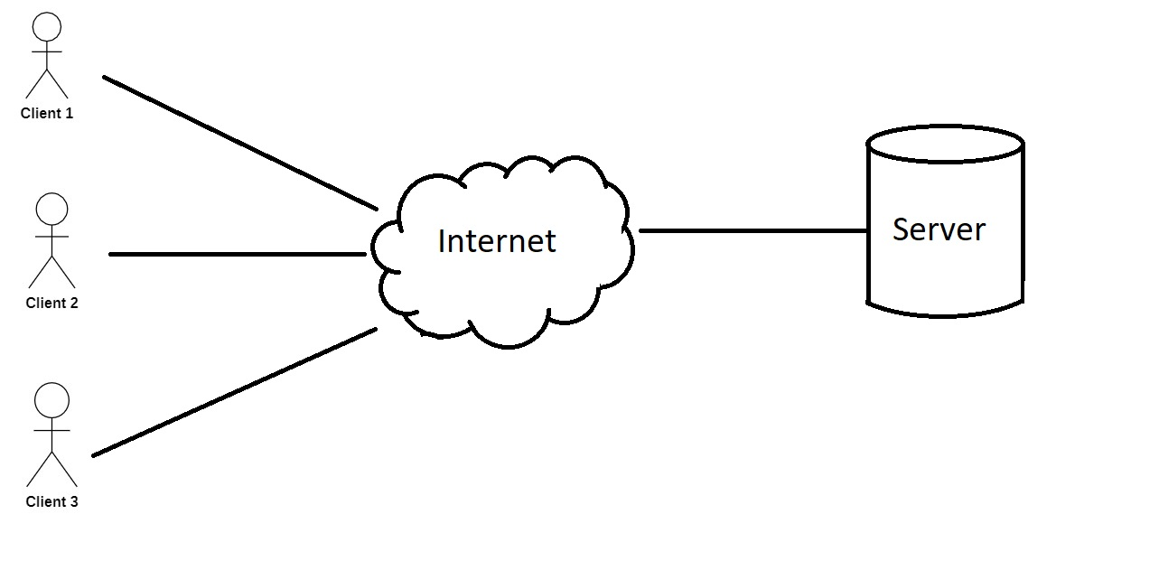
System design and architecture
A client server based architecture

Slide 16
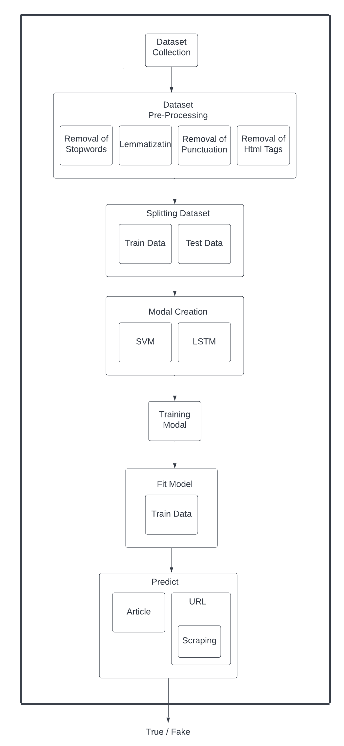
System overview

Slide 17
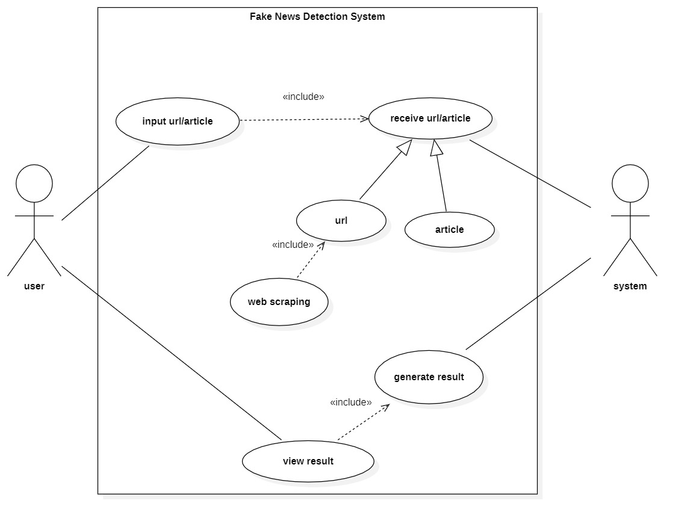
Use case diagram

Slide 18
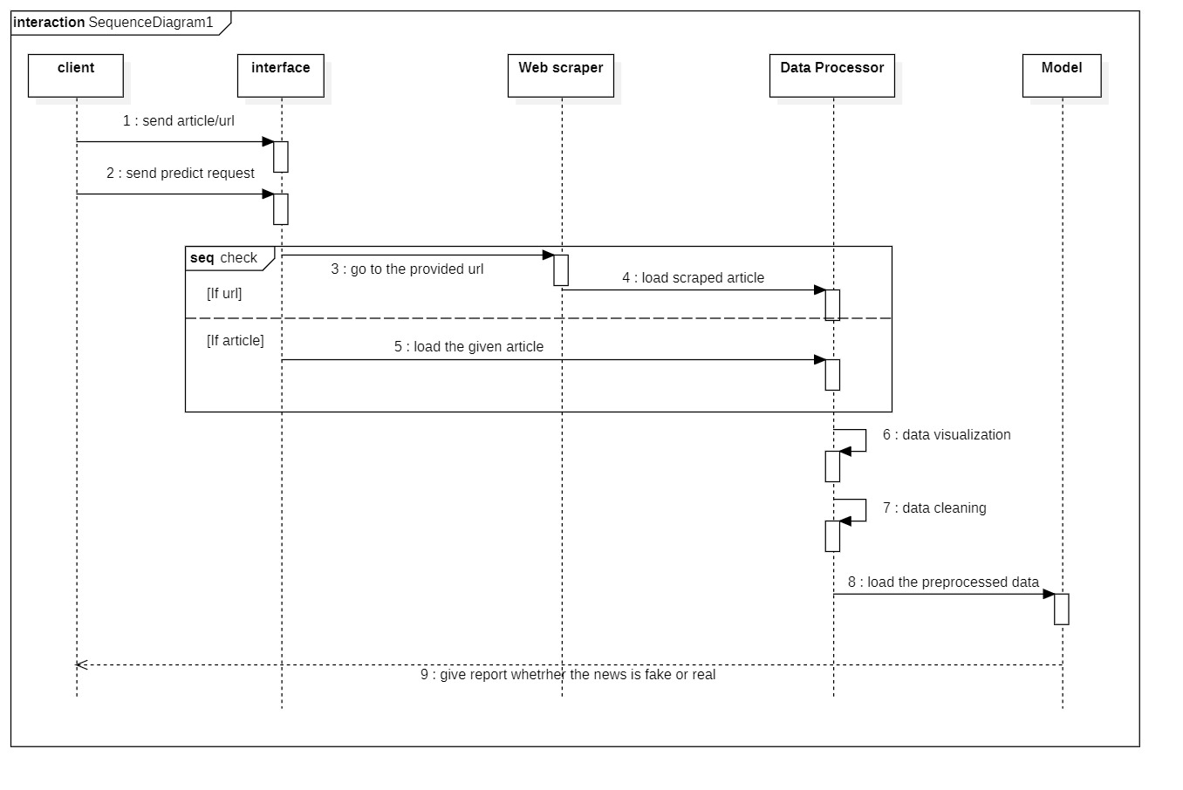
Sequence diagram

Slide 19
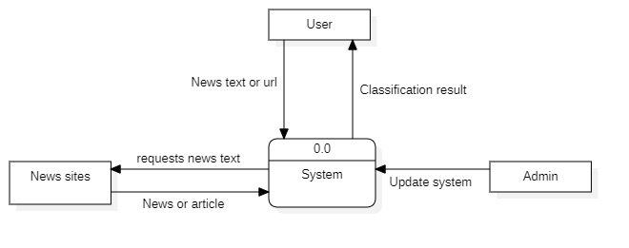
Data flow diagram
Figure: Level-0 DFD

Slide 20
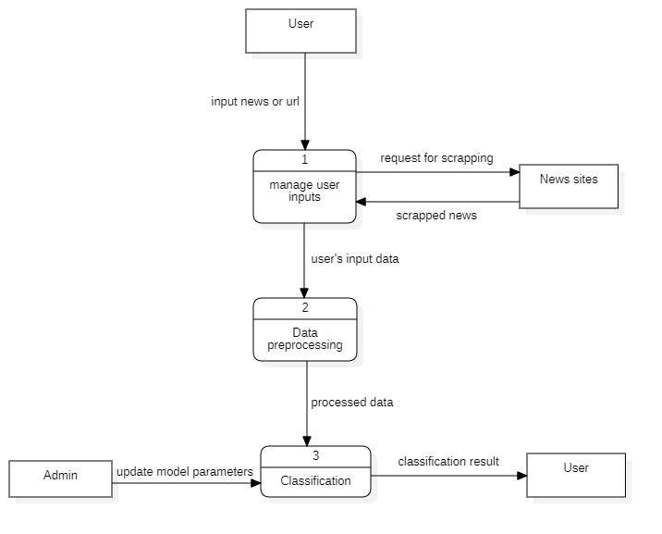
Figure: Level-1 DFD

Slide 21
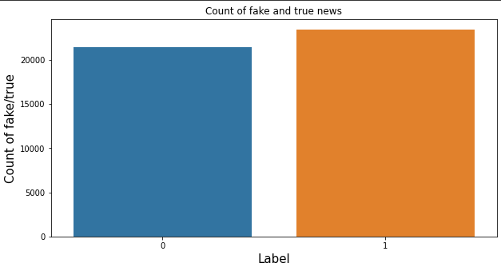
Data collection
Datasets for the projects are collected from Kaggle.
Number of True data = 21417 (labelled as 0)
Number of Fake data = 23460 (labeled as 1)

Slide 22
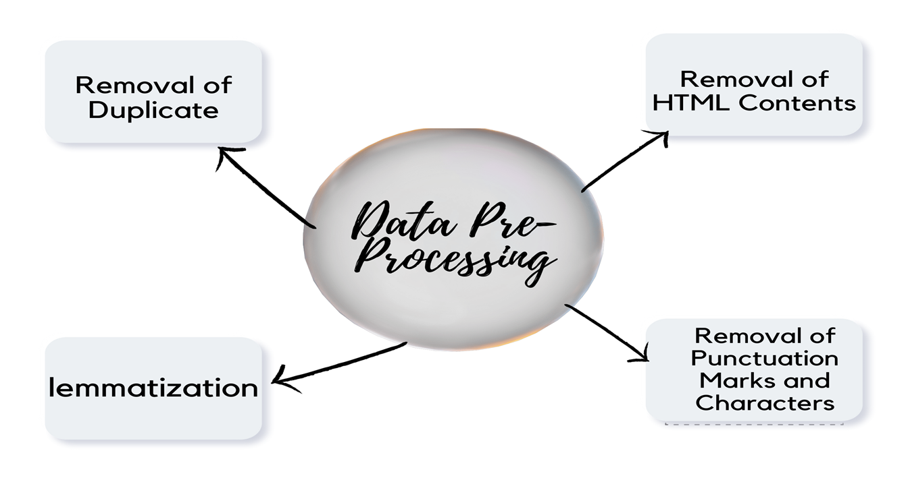
Dataset preprocessing

Slide 23
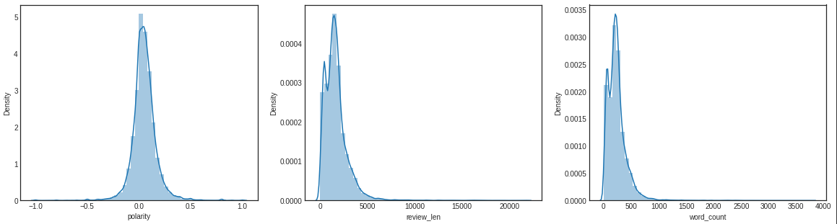
feature extraction

Slide 24

implementation
A Web site

Slide 25
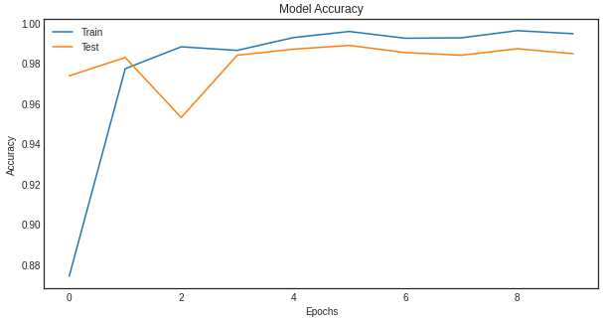
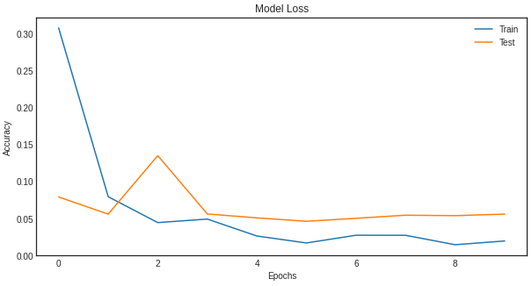
Accuracy and loss functions
Accuracy plot
Loss plot

Slide 26
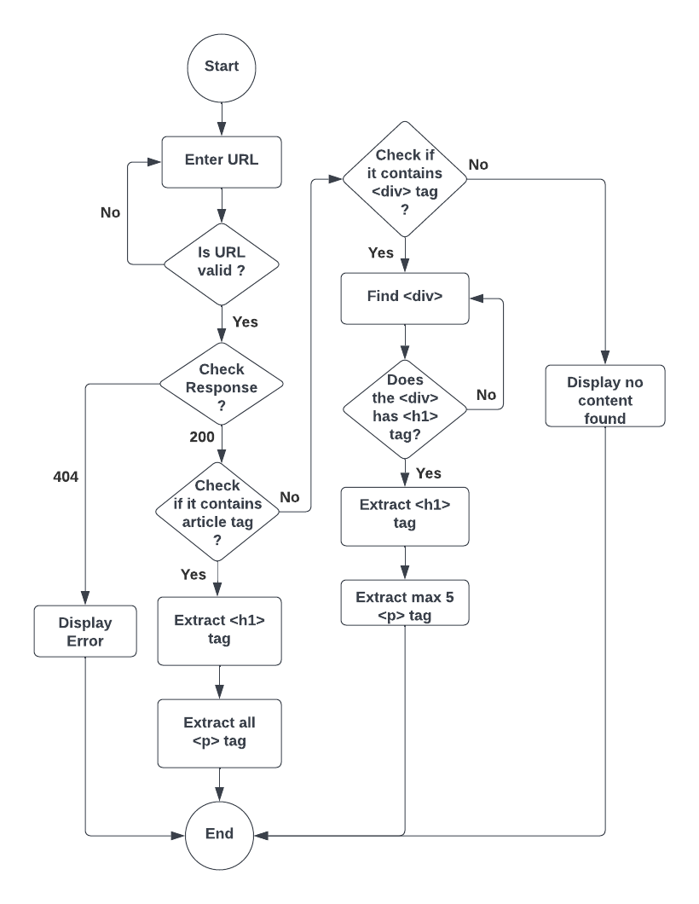
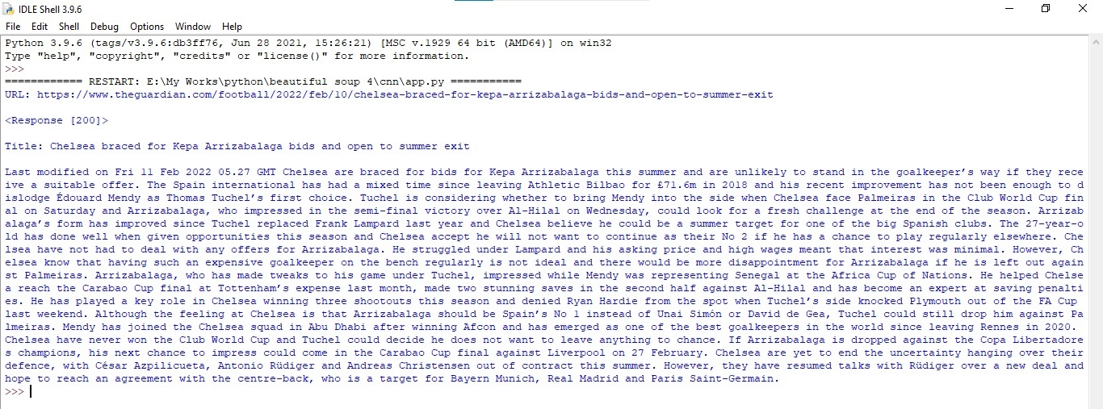
web scraping

Slide 27
limitations
Only one domain(politics).
Only for English Language.
Lower accuracy for real world data.

Slide 28
Future enhancements
Using custom datasets
01
Expanding our domain
02
Creating nepali datasets for nepali news detection
03
Increasing accuracy for real-world data
04

Slide 29

conclusion
Implemented SVM and LSTM classifier to distinguish whether the news is True or Fake.

Slide 30
references
[1] R. K. Kaliyar, “Fake news detection using a deep neural network,” in 2018 4th International Conference on Computing Communication and Automation (ICCCA). IEEE, 2018, pp. 1–7.
[2] R. K. Kaliyar, A. Goswami, P. Narang, and S. Sinha, “Fndnet–a deep convolutional neural network for fake news detection,” Cognitive Systems Research, vol. 61, pp. 32–44, 2020.
[3] H. Ahmed, I. Traore, and S. Saad, “Detecting opinion spams and fake news using text classification,” Security and Privacy, vol. 1, no. 1, p. e9, 2018.
[4] M.-A. Abbasi and H. Liu, “Measuring user credibility in social media,” in Social Computing, Behavioral-Cultural Modeling and Prediction, A. M. Greenberg, W. G. Kennedy, and N. D. Bos, Eds. Berlin, Heidelberg: Springer Berlin Heidelberg, 2013, pp. 441–448.
[5] M. Granik and V. Mesyura, “Fake news detection using naive bayes classifier,” in 2017 IEEE First Ukraine Conference on Electrical and Computer Engineering (UKRCON), 2017, pp. 900–903.
[6] S. Gilda, “Notice of violation of ieee publication principles: Evaluating machine learning algorithms for fake news detection,” in 2017 IEEE 15th Student Conference on Research and Development (SCOReD), 2017, pp. 110–115.
[7] P. Bahad, P. Saxena, and R. Kamal, “Fake news detection using bi-directional lstm-recurrent neural network,” Procedia Computer Science, vol. 165, pp. 74–82, 2019, 2nd International Conference on Recent Trends in Advanced Computing ICRTAC -DISRUP - TIV INNOVATION , 2019 November 11-12, 2019. [Online]. Available: https://www.sciencedirect.com/ science/article/pii/S1877050920300806
[8] R. Oshikawa, J. Qian, and W. Y. Wang, “A survey on natural language processing for fake news detection,” arXiv preprint arXiv:1811.00770, 2018.
[9] M. Umer, Z. Imtiaz, S. Ullah, A. Mehmood, G. S. Choi, and B.-W. On, “Fake news stance detection using deep learning architecture (cnn-lstm),” IEEE Access, vol. 8, pp. 156 695–156 706, 2020.
[10] M. G. Hussain, M. Rashidul Hasan, M. Rahman, J. Protim, and S. Al Hasan, “Detection of bangla fake news using mnb and svm classifier,” in 2020 International Conference on Computing, Electronics Communications Engineering (iCCECE), 2020, pp. 81–85.
[11] J. Shaikh and R. Patil, “Fake news detection using machine learning,” in 2020 IEEE International Symposium on Sustainable Energy, Signal Processing and Cyber Security (iSSSC), 2020, pp. 1–5.

Slide 31

Thank you

